Slide 1

What is Robotic Process Automation?
RPA Definition
Robotic Process Automation or RPA is a software that replicates the actions of a human being interacting with the user interface of a computer system, configured to follow defined business rules.
RPA can do repetitive processes quickly, accurately and tirelessly Free agents to do other tasks requiring:
Emotional Intelligence
Reasoning
Judgement
Interaction with other human beings
RPA represents a new, highly flexible, and rapidly scalable digital workforce - one that operates 24x7, executes transactions 100% compliant with defined business rules and reduces the “robotic” component of human work.

Slide 2
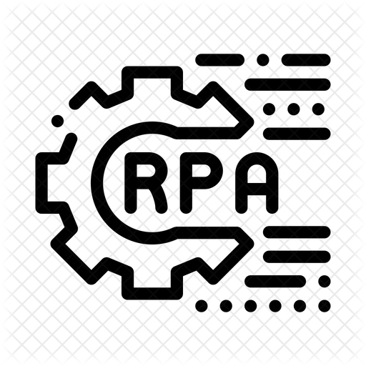



RPA TOOLS
01
Open Bots
02
RoboCorp
03

Slide 3
04
Month
Robocorp, Uipath and OpenBots RPA Developer
03
Month
OpenBots , Uipath RPA Developer and Robocorp Beginner
02
In the next 4 months you will be equipped with Expertise on RPA tools like Uipath, Openbots and Robocorp with realtime usecases
Month
TIMELINE
Uipath’s Advanced RPA Developer and OpenBots Beginner
01
Month
Uipath Fundamentals and RPA Advanced Professional
50%
50%

Slide 4
Jan-Mar
1
Ability to learn and develop Use cases with the expertise captured during the training program
Apr-Jun
Roles and Responsibilities
2
Contribute innovative ideas in designing workflows and ability to play as a team player during different phases of the Project
Jul-Sep
3
Responsible to Develop, Test and Deploy the RPA components developed with guidance from the RPA Lead/Senior Developer
Oct-Des
4
To get certified in the RPA platforms and clear RPA evaluation exam – Includes performing RPA Tasks on daily basis and develop POC’s for Projects

Slide 5

QUESTIONS

